Slide 2
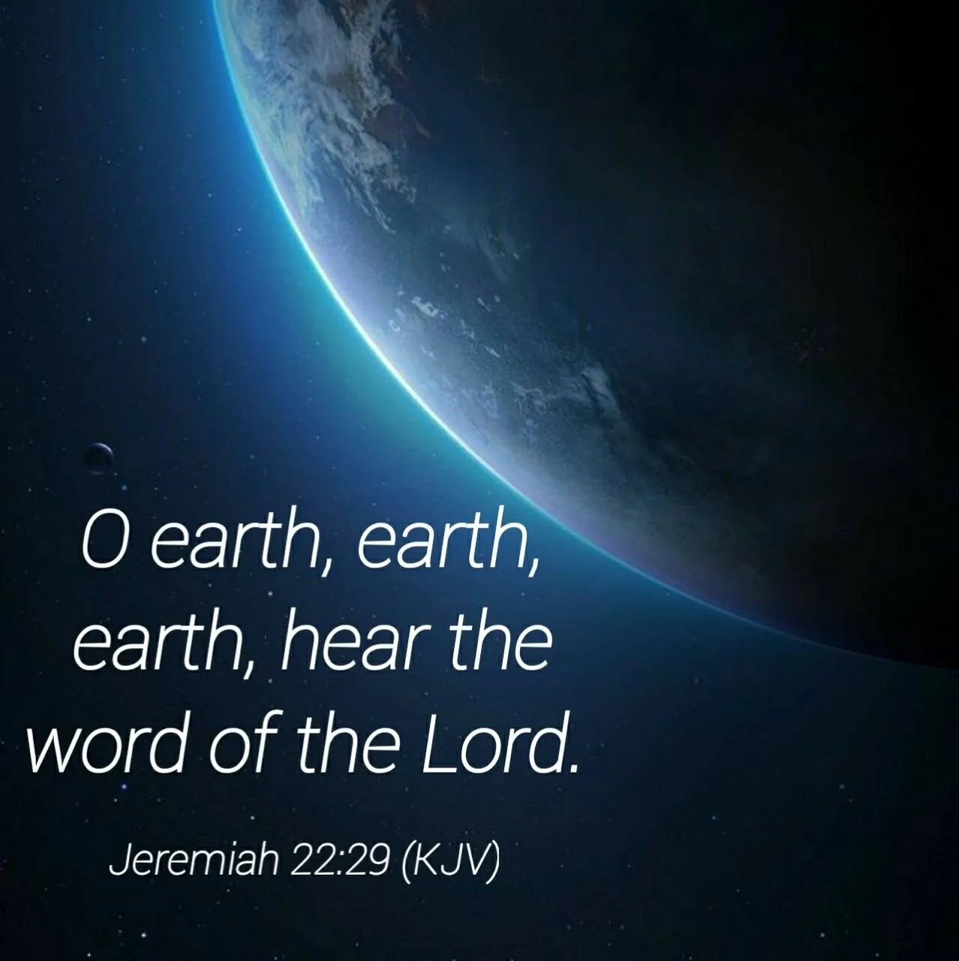
“Hear the word of the lord!”
Jeremiah 22:29

Slide 3
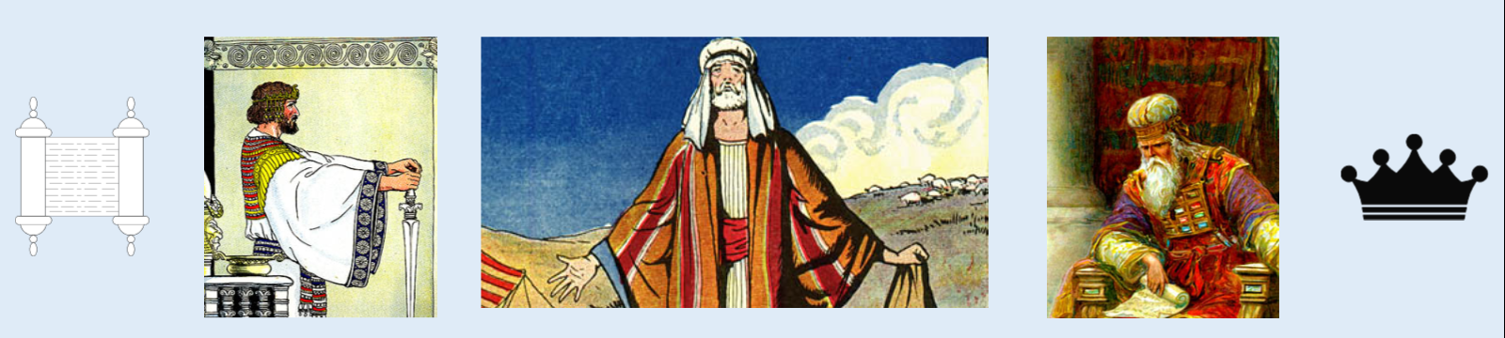
Prophets, priests, kings all corrupt!
Jeremiah 5:31; 6:13; 23:14

Slide 4

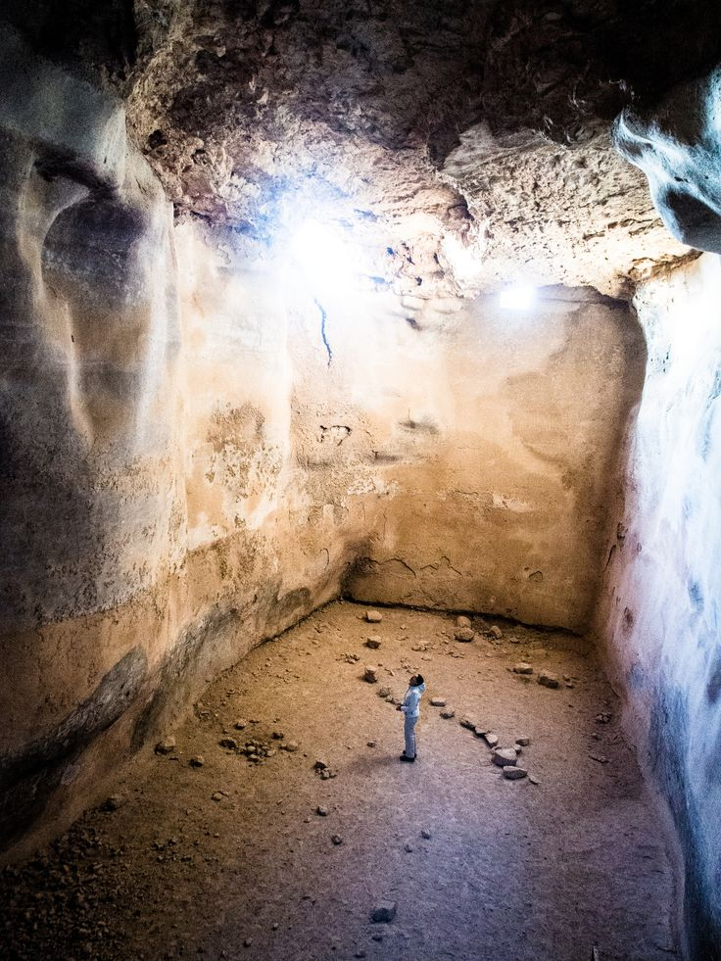
God had been forgotten
Jeremiah 2:13 “committed two evils” “forsaken Me” “hewn themselves cisterns”
Jeremiah 2:27 “turned their back to Me”
Jeremiah 2:28 “where are your gods that you have made for yourselves?”

Slide 5
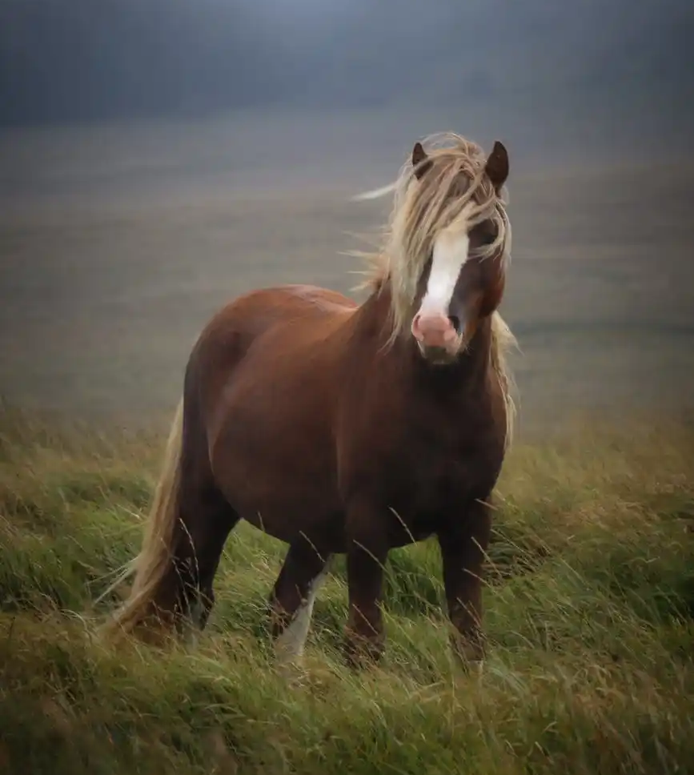
Adultery was common among the people
Jeremiah 5:7,8 “How shall I pardon you for this? Your children have forsaken Me And sworn by those that are not gods. When I had fed them to the full, Then they committed adultery And assembled themselves by troops in the harlots’ houses. 8 They were like well-fed lusty stallions; Everyone neighed after his neighbor’s wife.”

Slide 6
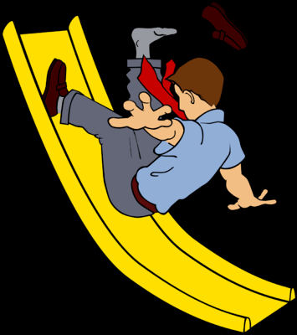
Perpetually backsliding
Jeremiah 8:5 NKJV 5 Why has this people slidden back, Jerusalem, in a perpetual backsliding? They hold fast to deceit, They refuse to return.”
“never ending or changing.”

Slide 7
continued EVIL COURSE
Jeremiah 6:16 “ask for the old paths, where the good way is, And walk in it.”
Jeremiah 8:6 “No man repented of his wickedness”
THE DEATH KNELL OF JUDAH
Jeremiah 22:24-30 ““Is this man Coniah a despised, broken idol…” “A man who shall not prosper in his days; For none of his descendants shall prosper, Sitting on the throne of David, And ruling anymore in Judah.”

Slide 8
Refused to hear god’s word
Jeremiah 13:10 NKJV 10 'This evil people, who refuse to hear My words, who follow the dictates of their hearts, and walk after other gods to serve them and worship them, shall be just like this sash which is profitable for nothing.”

Slide 9
Today destruction awaits those who refuse to hear god’s word
Acts 3:22,23 “Him you shall hear in all things”
2 Thessalonians 1:7,8 “taking vengeance on those who do not know God, and on those who do not obey the gospel of our Lord Jesus Christ.”

Slide 10
“Hear the word of the lord!”
Jeremiah 22:29

Slide 11
The term “hear” has many uses
Perception of sounds when source not visible- Acts 9:7; John 12:27,28
To Perceive by the ear what is spoken while in one’s presence – Acts 22:9
To get by Hearing, to Learn – Matthew 10:27
To find out, to learn by the Hearing of Others- Matthew 11:2

Slide 12
The term “hear” has many uses
To Listen to, Hear Attentively – Luke 19:47,48
To Comprehend, to Understand – Mark 4:33
To Yield to, to Hear and Obey, to Heed One- Acts 3:22,23

Slide 13
Hearing that is attentive, understood and obeyed

Slide 14
What is it that we are to “hear?”
THE WORD OF THE LORD!
Jeremiah 23:16,17 “everyone who walks according to the dictates of his own heart, they say, ‘No evil shall come upon you.”
Jeremiah 23:21.25-28 “I have not spoken to them, yet they prophesied.”

Slide 15
Problem did not cease with Jeremiah
Continued Down Through The Ages

